Slide 1
Analysis of High-Dimensional Proteomics Data:
Networks and Topological Data Analysis
Austin Chan, Janet Loyola, Iyesha Puri, Sophia Su, Roger Zhou
Notes:
We are trying to do some data analysis on high-dimensional data.
The method we use includes network methods and topological data analysis
By using these two methods, we can not only kinda visualize the data, but also get some insightful information.
Since there are two methods, we split into two group. Our group is focusing on networks method. And later, our colleague will talk more about TDA method.

Slide 2
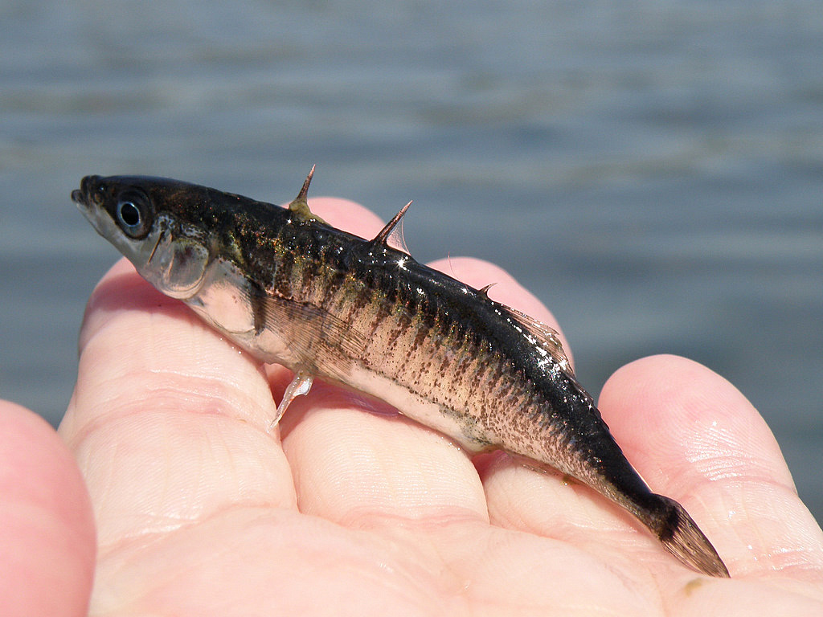
Stickleback fish
Notes:
Fish / Correlation of the data

Slide 3
Scientific Question / Reasoning
What is the goal of this project?
Association between protein expression of stickleback fish and environment
What do we hope to find?
Do proteins appear jointly? Are there specific patterns of protein abundances among different environments?
Discover some underlying features or structures that are consistent throughout the analysis
Notes:
Based on the given data, we know the relative abundance the of proteins but don‘t know how active the proteins are
We calculate correlation between each pair of proteins - which is the relative distance of proteins...compare them in all environments
Are the proteins connected to one another (in other words do the proteins appear jointly)? Are there specific patterns of protein abundances seen over the different environments?
Want to discover some underlying features or structures that are consistent throughout the analysis, because If proteins express themselves jointly, they are likely to be critical to the organic functions of the fish
On the other hand, if certain proteins show up jointly in some environments but not in others, the environmental conditions actually play a role on the protein expression
Networks provides us with a strong tool to visualize structure of the data (connections are formed if the proteins are jointly expressed...that is based on the statistical distance we assume a structure)
Although TDA serves many purposes, in our project, TDA tracks how substructures form and if they form a larger structure together. If a structure forms, does it persist for a long time -- gives us something to look into, helps find prominent structures.

Slide 4
What do the data look like?
High-Dimensional Objects
1505 different proteins
96 fish from 4 different environments
Hence, 24 fish for 1 environment
Low sample size
Number of variables is significantly larger than the sample size
Large P, small n
Low sample size is problematic due to larger variance in the data
Correlation - Distance matrix
Used to compare the relationships between each protein
Notes:
Over 20 thousands proteins to begin with ->Thanks to doc. Kueltz and his colleges great effort -> condense to 1505 most significant proteins.
In our data set, there are 96 fish …..
Distance matrix = 1 - correlation^2

Slide 5
What do the data look like? (cont.)
Protein 1 | Laguna de la Bocana del Rosaria Warm Salt Water | Bodega Harbor Cold Salt Water | Lake Solano Cold Fresh Water | Westchester Lagoon Cold Salt Water
1505 proteins | T: 30 °C Salinity: 10g salt/kg 24 fish (taken as 4 samples of 6 fish) | T: 14 °C Salinity: 35g salt/kg 24 fish (taken as 4 samples of 6 fish) | T: 14 °C Salinity: 0g salt/kg 24 fish (taken as 4 samples of 6 fish) | T: 12 °C Salinity: 10g salt/kg 24 fish (taken as 4 samples of 6 fish)
Notes:
Each fish has 1505 proteins and we have 96 fish. These fish are sampled from 4 different environments each with varying salinity and temperature: warm salt water... 24 fish in each environment.

Slide 6
What do the data look like? (cont.)
Notes:
Originally ~20,000 proteins. Thanks to the work of Dr. Kueltz (Dietmar)
This is an example of how protein G3N3Z8 is expressed in each environment
of all 4 environments (however, only 1 sample of each environment - there are 6 samples of each environment)
The data points represent the relative abundance of specific protein in gill epithelium cells
The data is normalized against the sum of all 1505 proteins
(Sum represents intensity of entire sample)
By eye level we we can see the differences in protein expression. But on a larger scale (given 1505 proteins) its hard to see how how the proteins are related. Therefore we use Network analysis to visualize these relationships

Slide 7
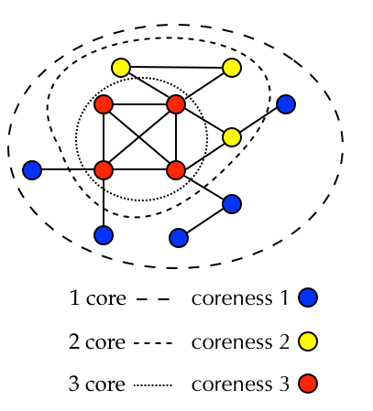
Network Analysis
K-Core Peeling Method
Finding the central node of a network, highly connected nodes (proteins) appear in the center of the network
Peeling insignificant clusters of data points from the outside in by eliminating nodes of increasing discrete vertex degree; stop when peeling discontinues
Notes:
Network analysis allows us to visualize the relationships between individual proteins and protein structures. We do this to get a sense of how proteins are related. However, the network is dense so it is hard to tell what the significant structures are. Our second step here is using peeling methods to reduce noise and see relevant structures.
To find the central node of a network, we used the K-Core peeling method in which we peel insignificant clusters of data points from the outside in by eliminating nodes of increasing discrete vertex degree (these are based on a cutoff value that represents correlation). After peeling insignificant layers, we end up with a core of proteins that show a highly connected structure of clusters.

Slide 8
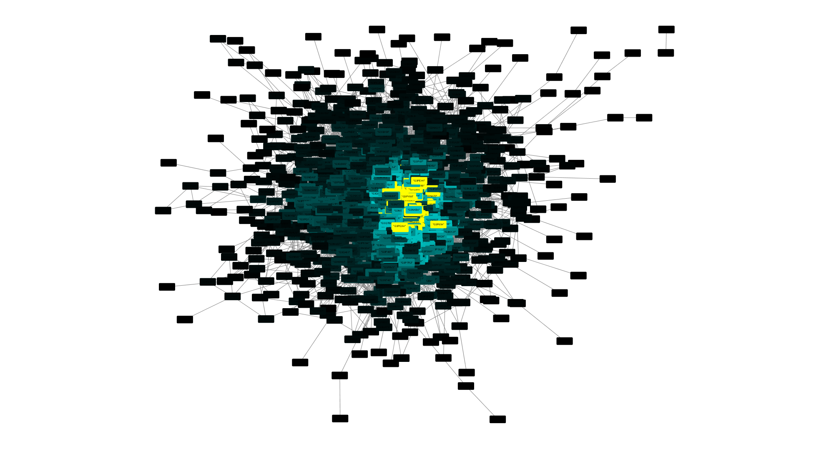
Cytoscape Graph of the fish in all environments
Notes:
Cytoscape
Peeling layer by layer (~60 layers color-coded)
Allows us to compare the cores across different environments

Slide 9
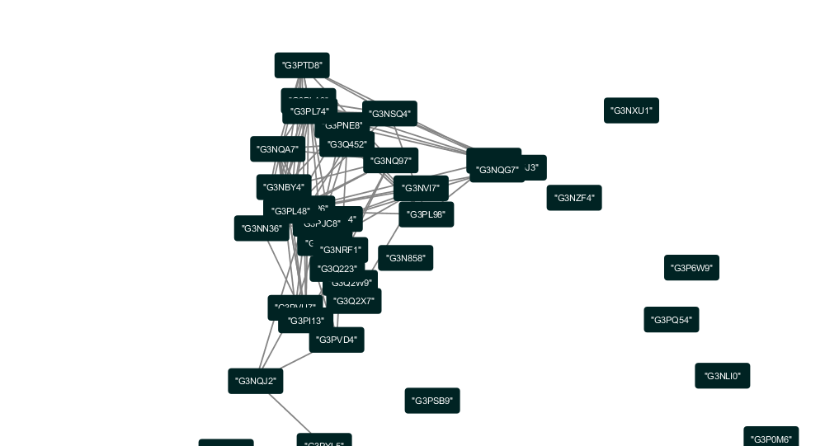
Layer 10 from previous network graph

Slide 10
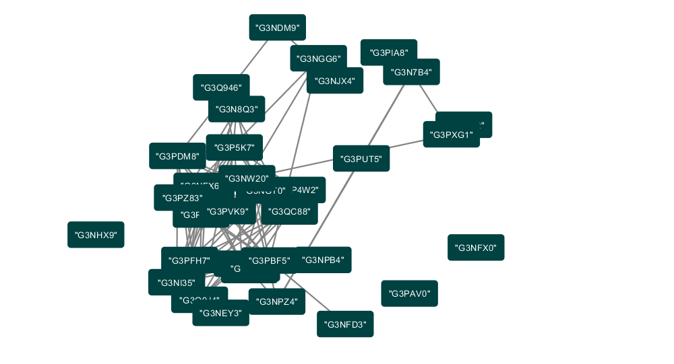
Layer 18

Slide 11
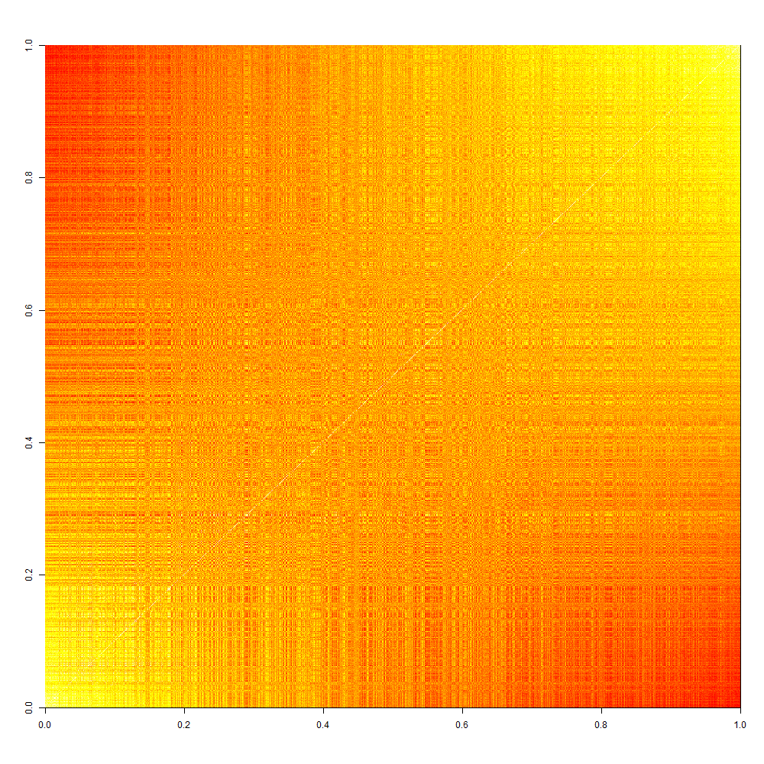
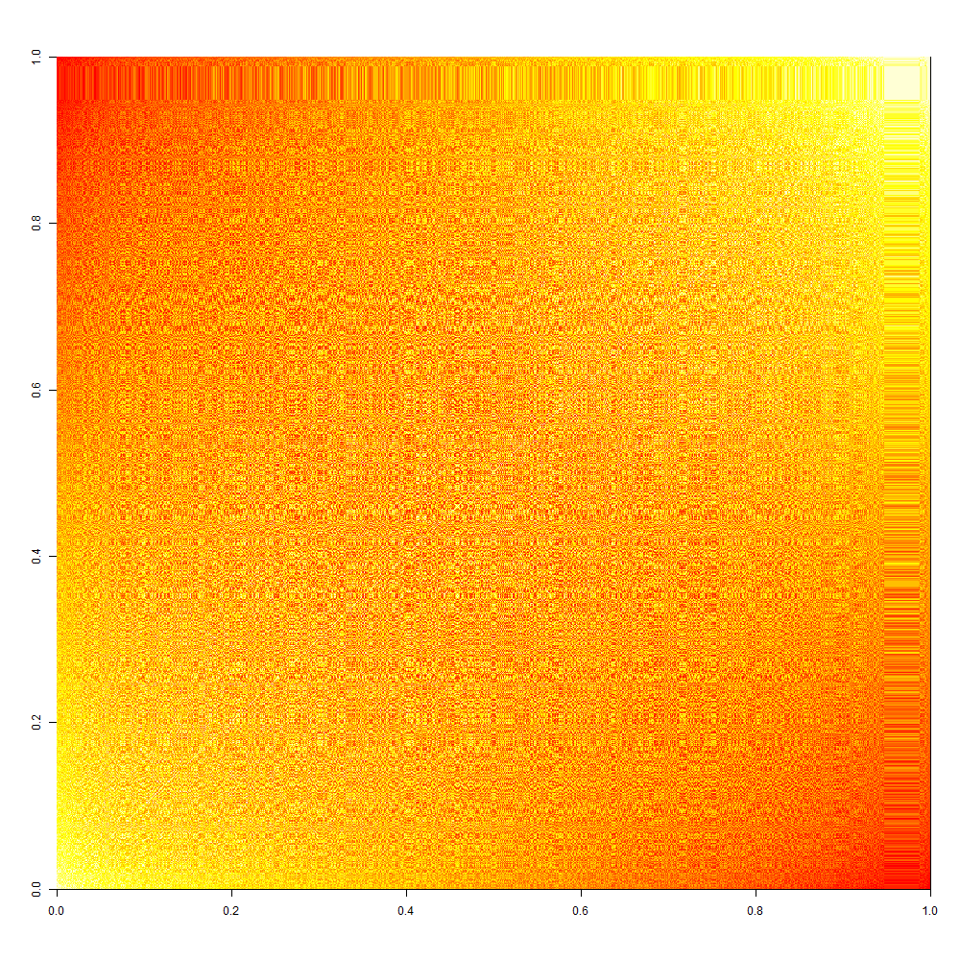
Bootstrap & Simulation
Notes:
Bootstrap: to test the robustness and consistency of the data structure; replicate the data => difficult to track
Simulation: no signal (effect of the noise); provide the benchmark/distribution to help understand the random fluctuation.
Set a benchmark so that we can compare our analysis with a certain standard and determine to what extent has the noise contaminated our data
Conclusion: We believe that we have an acceptably low level of noise

Slide 12
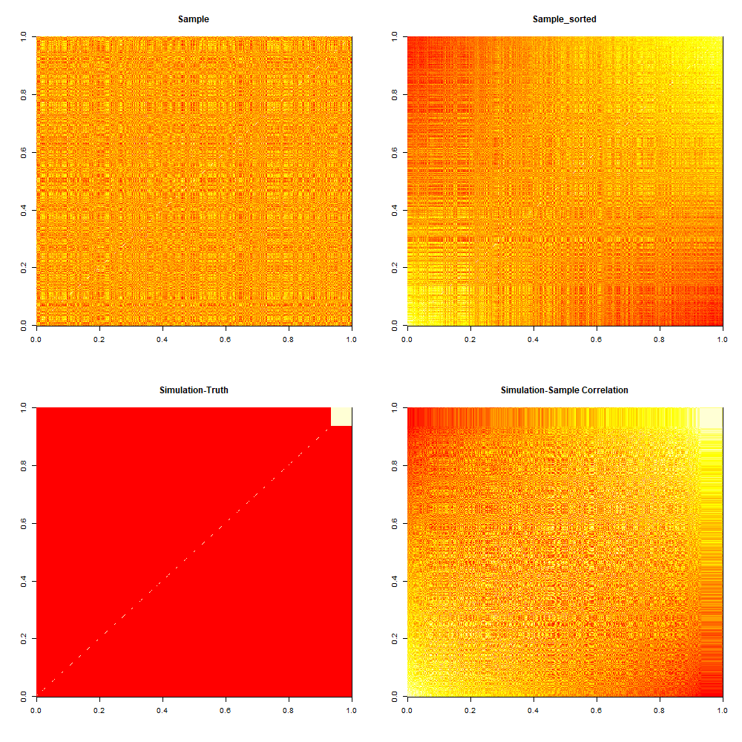
Notes:
However, Based off of discrete arbitrary cut-offs. No scientific justification - don’t know if these structures are relevant.
Now that we would like to have more control in order to solve this issue, we moved on to the methods of Topological Data Analysis.

Slide 13
Basic TDA Structure Example
ε = 0, Sample size = 30
ε = 0.5, no loops
ε = 0.8, 1-D hole appears
Summary
Notes:
How TDA is better than Networks?
TDA is an overview of what happens to the network across all the distances and we can see the progression of their growth. However, networks is only one detailed instance. Hence, we decided to move on to TDA. This is the idea behind TDA.
With network analysis, we are peeling away proteins whereas with TDA we are building up the network from the individual proteins. TDA allows us to see super structures that networks couldn’t help us see. For example: rings.
So from our dataset, the sample points represent proteins and the circles represent distances.
There are 30 data points sampled from a circle of radius 2. In the 2nd pic, epsilon=0.5. Epsilon is the distance (threshold). When it is 0.5, the set consists of two connected components and zero loops.
As we keep increasing epsilon, we assist at the birth and death of topological features.
In the 3rd pic, epsilon=0.8. When it is 0.8, one of the connected component dies and a hole (super structure) appears.
The persistence diagram summarizes the topological features of the sampled points. The black dots represent the connected components. 30 connected components are present at epsilon=0, and they progressively die as epsilon increases, leaving only one connected component. The red triangle represents the super structure that appears at epsilon=0.8 and dies at epsilon=2.
But if we had a fixed epsilon, then it is a snapshot of the network that Roger talked about before in the k-core method with epsilon=0.6.

Slide 14
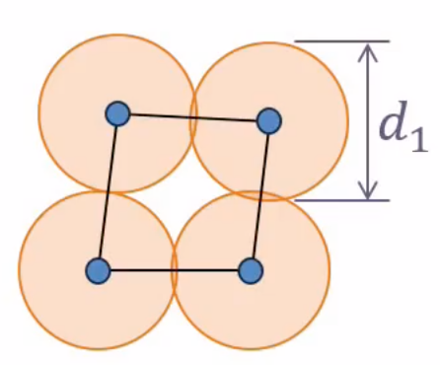
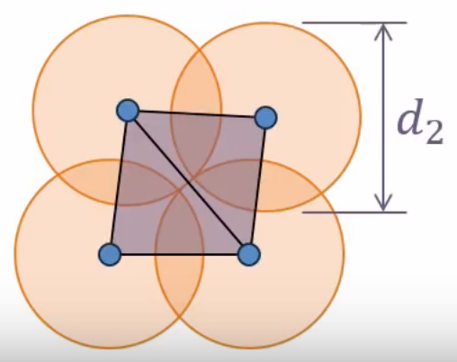
Birth and Death in Persistence Diagrams
Figure 1
Figure 2
Figure 3
Notes:
Each hole appears at a particular value of d and disappears at another value of d.
In figure 1, d1 is the smallest distance for these four edges to appear creating a hole in the middle.
In Figure 2, there is another distance d2 which is just large enough for the two triangles to get filled in and there is no hole. So, hole appears in distance d1 and disappears at distance d2.
We can represent the persistence of this hole as a pair (d1,d2), or as a bar from d1 to d2. This is what is shown in Figure 3. A collection of these bars is called a barcode. Basically, a barcode is a visualization of an algebraic structure. In the next slide, you are going to watch a short video to understand this better.

Slide 15
Notes:
As the balls start to grow, edges start to appear and the complex gradually becomes connected. A few small holes appear but quickly become filled in. A large central hole appears and remains for a while.
The small holes that appear first are due to noise. Hence, short bars on the barcode represents noise. Long bars represents features and that is what we are interested in.

Slide 16
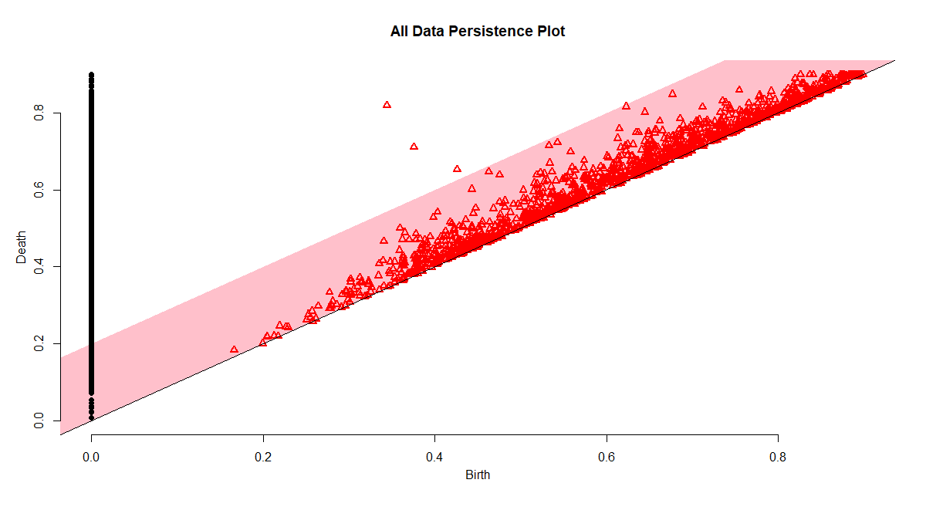
Persistence Plot for all Fish
Notes:
This persistence diagram allows us to distinguish the significant features from the noise.
So, the red bar in this diagram is the confidence interval for the noise.
Everything within the red bar is disregarded as noise.
We are only interested in super structures that occur outside of the red bar.
As we can see from the plot, there are three significant structures.
We assume that these significant structures are important.
However, one main problem we had was that we didn’t know whether the structure was robust or if it occurred at random.
To address this problem, we performed bootstrap sampling on the data to see if these structures were actually significant.

Slide 17
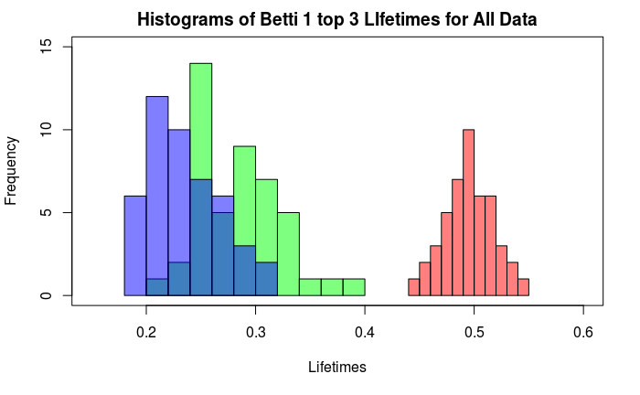
TDA Bootstrap Graph
Notes:
The results from the bootstrap are shown above.
As you can see from this graph, there is a clear distinction between the structure with the longest lifetime and the next two structures.
If the structures were random, then we would expect that the distribution of the longest living structure would be indistinguishable from the other two structures.
However, this structure does not overlap at all with the other two structures, so we concluded that the longest living structure is significant.
We ran this bootstrap analysis on each environment separately and came to the same conclusion for each environment.
Notice that for each environment, the longest living structure is clearly separated from the other two structures.
Given that there is a prominent structure for each environment, we wanted to find out which proteins belong to these structures.
By understanding which proteins are in which structure, we can determine whether the structure has any biological significance.
Unfortunately, the problem with TDA is that it can tell you that a structure exists, but has difficulty tracking which proteins belong to that structure.
Currently, we are working on how to address this problem.
In the future, we plan to compare the proteins found these structures to proteins in known chemical pathways to see if there is an overrepresentation of a particular pathway in our network.
Hopefully, we can find key proteins that may give us insight on the significance of these long living structures.

Slide 18
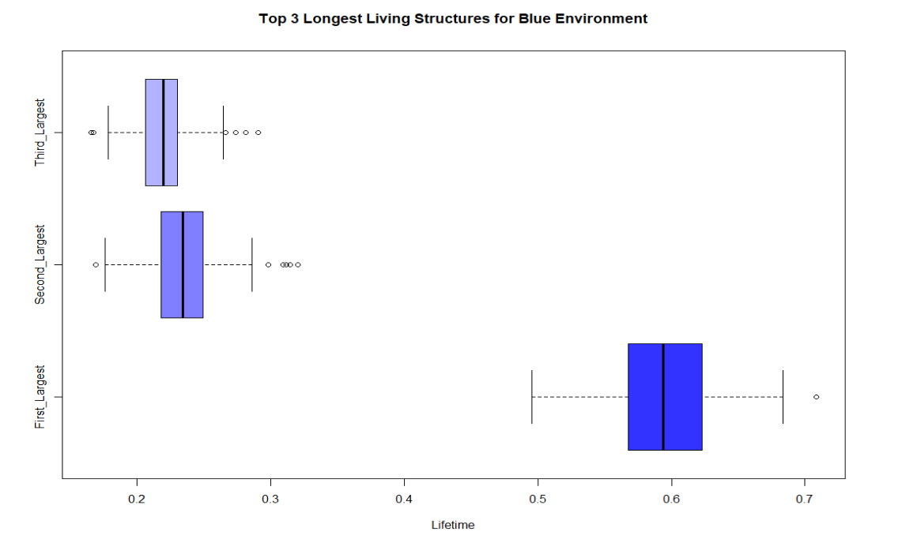
TDA Bootstrap for Blue Environment

Slide 19
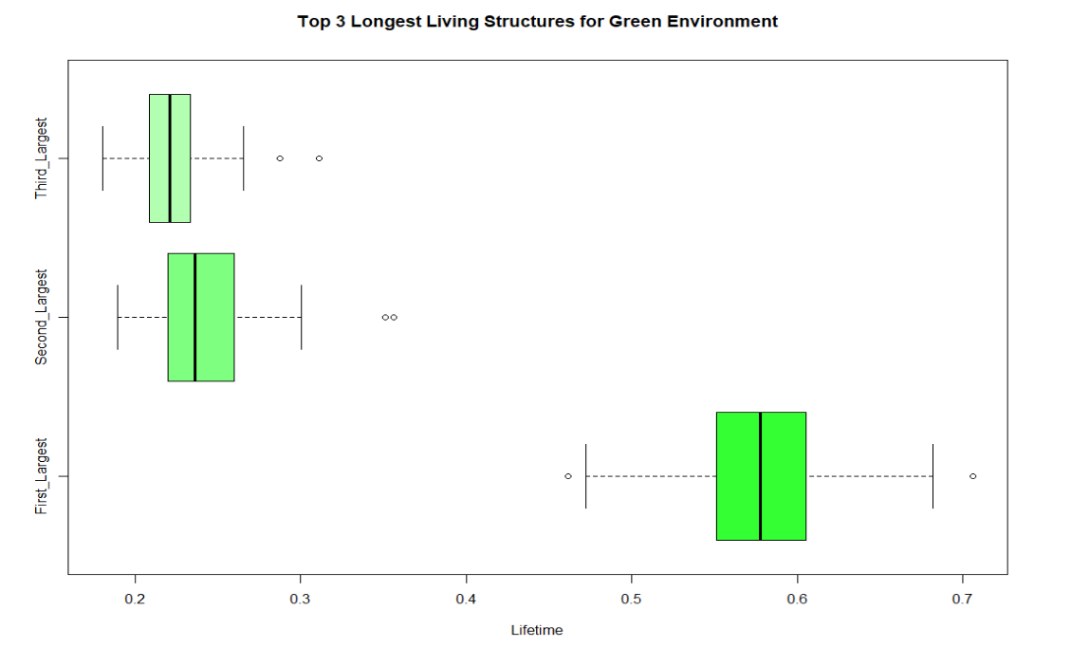
TDA Bootstrap for Green Environment

Slide 20
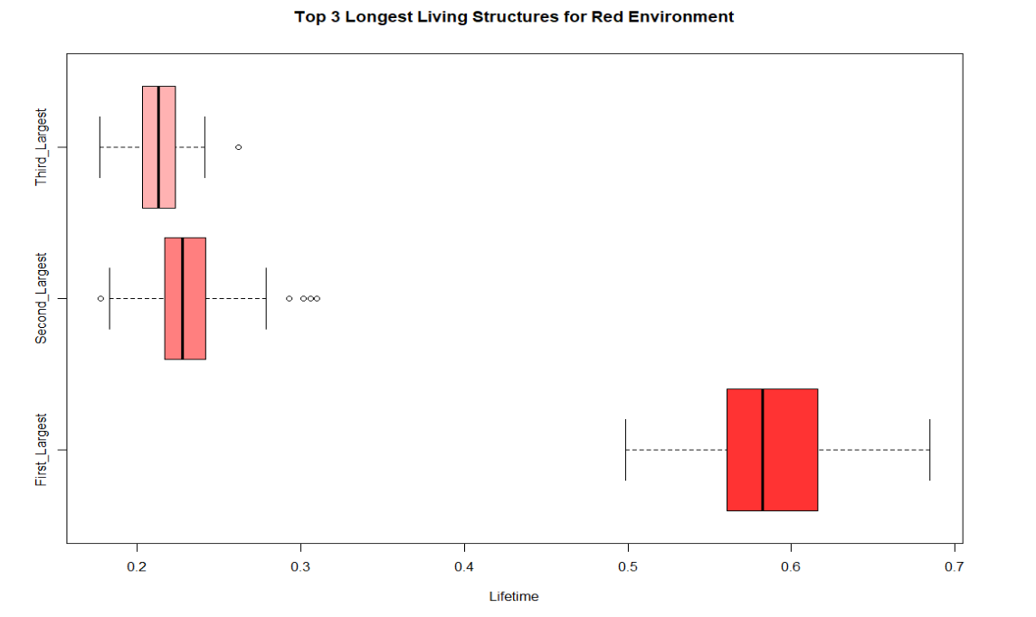
TDA Bootstrap for Red Environment

Slide 21
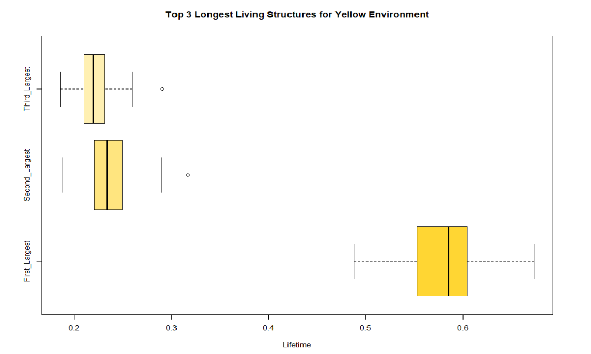
TDA Bootstrap for Yellow Environment

Slide 22
Contributors
Faculty Mentors:
Javier Arsuaga, Dietmar Kueltz, Wolfgang Polonik
Graduate Student Researchers:
Irene Kim, Benjamin Roycraft
Undergraduate Student Researchers:
Austin Chan, Janet Loyola, Iyesha Puri, Sophia Su, Roger Zhou

Slide 23
References
Fasy, B. T.; Lecci, F.; Rinaldo, A; Wasserman, L.; Balakrishnan, S.; and Singh, A. Confidence Sets For Persistence Diagrams. 2014.
K.-Y. Ho, “TDA (1) – Starting the Journey of Topological Data Analysis (TDA)“, WordPress (2015)
https://datawarrior.wordpress.com/2015/11/03/tda-3-homology-and-betti-numbers/

